Slide 1

Disease prediction using machine learning

Slide 2
TEAM MEMBERS
Team Members:
L. N. V. Mukesh (URK18CS229)
M. Krishna Sai (URK18CS238)
S. V. Tharun Kumar Reddy(URK18CS247)
S. Rakesh(URK18CS246)
Guide:
Dr. R. Venkatesan , Asst . Professor

Slide 3
OUTLINE
Objective
Introduction
Problem Statement
Proposed System
Methodology
Implementation
Result
Conclusion

Slide 4
OBJECTIVE
To detect the various diseases through the examining symptoms of patient’s using different techniques of Machine Learning.
The predictions accuracy will increase using Machine Learning.
Doctors may sometimes fail to take accurate decisions while diagnosing the disease of a patient , therefore disease prediction systems which use machine learning algorithms assist in such cases to get accurate results.
This disease prediction using machine learning is completely done with the help of machine learning and python programming language and also using the dataset that is available previously by the hospitals using that we will predict the disease

Slide 5
INTRODUCTION
Machine learning disease prediction is a system that predicts based on information provided by users.
The project disease prediction using machine learning is being developed to beat general disease in earlier stages , as we know in a competitive economic development , mankind has been involved in so much that he/she isn’t concerned about.
According to research ,70 percent of people in India suffer from general disease, and 25 percent die as result of early ignorance.
The main reason for developing this project is so that a user can sit at their convenience and have check-up

Slide 6
PROBLEM STATEMENT
To know the disease in early stages of the symptoms this disease prediction will help a lot to the various people’s ranging from children to senior citizens.
It predicts the disease of the patient or the user based on the information or the symptoms enter into the web system and gives results based on that information.
The general purpose of this disease prediction is to provide prediction for the various and generally occurring diseases that when unchecked and sometimes ignored can turns into fatal disease and cause lot of problem.
The system processes the symptoms provided by the user as input and gives the output as the probability of the disease.

Slide 7
PROPOSED SYSTEM
The Proposed System of Disease Prediction using machine learning is that we have used many techniques and algorithms and all various tools to build system which predicts the disease of the patient using the symptoms and comparing with the system’s dataset that is previously available.
Decision tree, Naïve Bayes, tree-based random subspace classification algorithms can be used to predict disease patients
Both classification algorithms will be applied.
Results of both algorithms will be combined
According to the accuracy the result will be taken.

Slide 8
MODULES
Collecting Data
Data Preprocessing
Training Data
Testing Data
Prediction

Slide 9
METHODOLOGY AND TOOLS USED
METHODS
Decision Tree Algorithm :
In machine learning , the Decision Tree is the most powerful and widely used tool for categorization and prediction.
In general, decision tree classifiers have good accuracy.
There are two elements to the Decision tree algorithm : nodes and rules(tests).

Slide 10
METHODOLOGY AND TOOLS USED
Naïve Bayes Algorithm:
Naïve Bayes Algorithm is a supervised learning algorithm , which is based on Bayes theorem and used for classification problems.
It classifies the class data based on the training set and the values in a classifying attribute and uses it in classifying new data.
P(c|x) from P(c), P(x) and P(x|c) P(c|x)=P(x|c)P(c)/P(x)
TOOLS
Python(programming language)
Pycharm
Tkinter

Slide 11
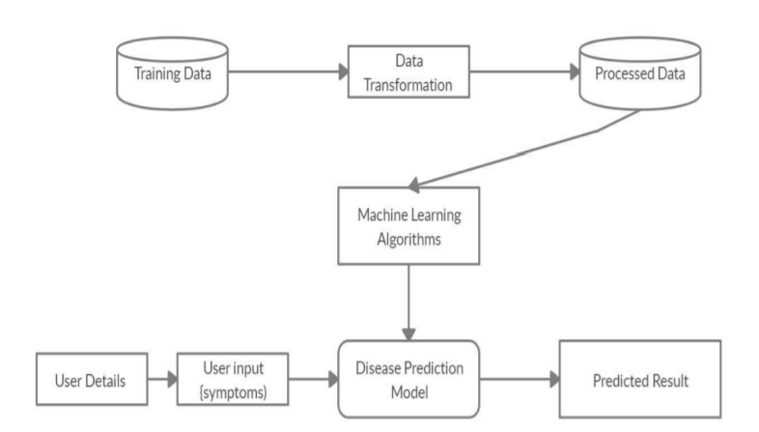
SYSTEM ARCHITECTURE

Slide 12
GUI
Tkinter is a python binding to the Tk GUL toolkit.
It is a Standard python interface to the Tk GUL toolkit shipped with python
Python with Tkinter outputs the fastest and easiest way to create the GUI applications.
Python offers multiple options for developing GUL(Graphical User Interface).
Out of all the GUI methods ,tkinter is most commonly used method

Slide 13
IMPLEMENTATION
The project is designed user friendly and also secure to use ever user requires a authentication to enter into the system after which it provides the result based on the user input.
After user enters the system user have to provide the symptoms which he/she is going through based on which we have several algorithms which predict the disease and also displays the percentage of accuracy.
In Unstructured analysis we select the features automatically with help of algorithms and techniques.

Slide 14
IMPLEMENTATION
The user needs to enter all the columns of symptoms to get the accurate result.
Data collection and data set preparation This will involve collection of medical information from various sources like hospitals, then pre-processing is applied on dataset which will remove all the unnecessary data and extract important features from data.
Training and experimentation on datasets The disease prediction model will be trained on the dataset of diseases to do the prediction accurately and produce confusion matrix.

Slide 15
IMPLEMENTATION
In this project 2 different algorithms were used- Decision Tree Algorithm and Naïve Bayes Algorithm.
Deployment and analysis on real life scenario the trained and tested prediction model will be deployed in a real life scenario made by the human experts & will be leveraged for further improvement in the methodology.

Slide 16
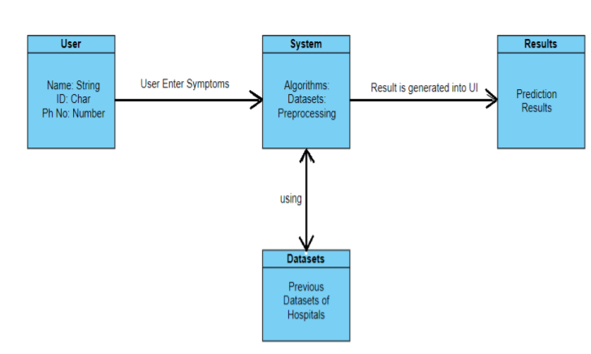
Implementation case Diagram

Slide 17
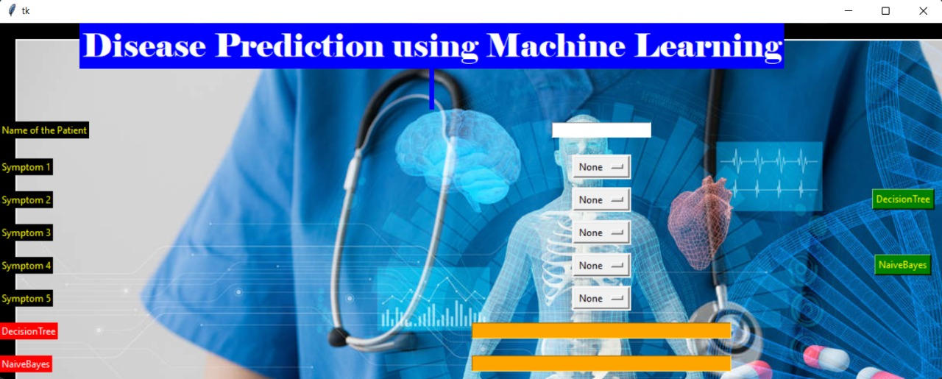
RESULT

Slide 18
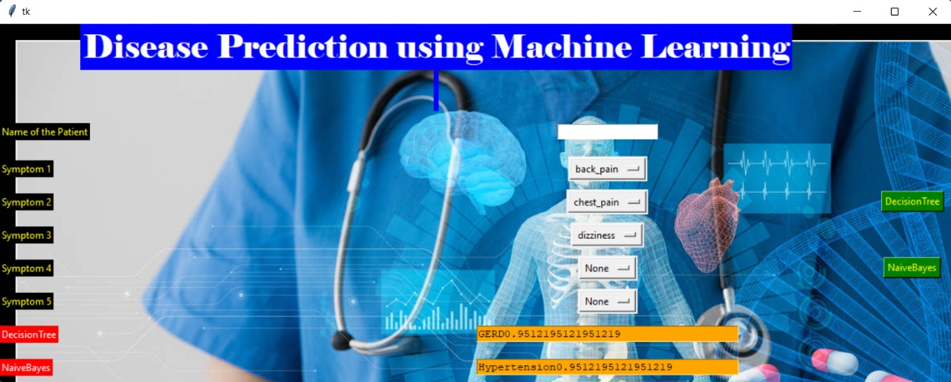
RESULT

Slide 19
conclusion
This project Disease prediction using machine learning is extremely much useful in everyone’s day to day life.
Now a day’s health industry plays major role in curing the diseases of the patients as this it is useful for the user I case he/she doesn’t want to go the hospital or any other clinic , so just by entering the symptoms and all other useful information the user can get to know the disease and health industry also easily predict the disease of the patient.
The Disease prediction is to provide prediction for the various and generally occurring diseases.

Slide 20
FUTURE SCOPE
Facility for modifying user detail.
More Interactive user interface.
Facilities for backup creation.
Can be done as mobile application.
More Details and More Diseases

Slide 21
REFERENCES
[1] Disease Prediction and Doctor Recommendation System by www.irjet.net
[2] Disease Prediction Based on PriorKnowledge by www.hcup- us.ahrq.gov/nisoverview.jsp
[3] GDPS - General Disease Prediction System by www.irjet.net
[4] Disease Prediction Using Machine Learning by International Research Journal of Engineering and Technology (IRJET).
[5] Kaveeshwar, S.A., and Cornwall, J., 2014, “The current state of disease mellitus in
India”. AMJ, 7(1), pp. 45-48.
[6] Dean, L., McEntyre, J., 2004, “The Genetic Landscape of Disease [Internet]. Bethesda (MD): National Center for Biotechnology Information (US); Chapter 1, Introduction to Disease. 2004 Jul 7.

Slide 22
REFERENCES
[7] Machine Learning Methods Used in Disease by www.wikipedia.com
[8] https://www.researchgate.net/publication/325116774_disease_prediction_using_machine_learning_techniques

Slide 23


